Slide 1
CoRP Science Symposium 2014
Evaluation of Trends in Chlorophyll-a Concentration in Response to Climatic Variability in the Eastern Bering Sea from MODIS
Puneeta Naik^{a,b} and Menghua Wangª
ªNOAA National Environmental Satellite, Data, and Information Service
Center for Satellite Applications and Research
College Park, MD 20740, USA
^{b}CIRA, Colorado State University, Fort Collins, CO 80523, USA
Acknowledgements: We thank Drs. Eurico D’Sa and Calvin Mordy for the in situ data in the Bering Sea.

Slide 2
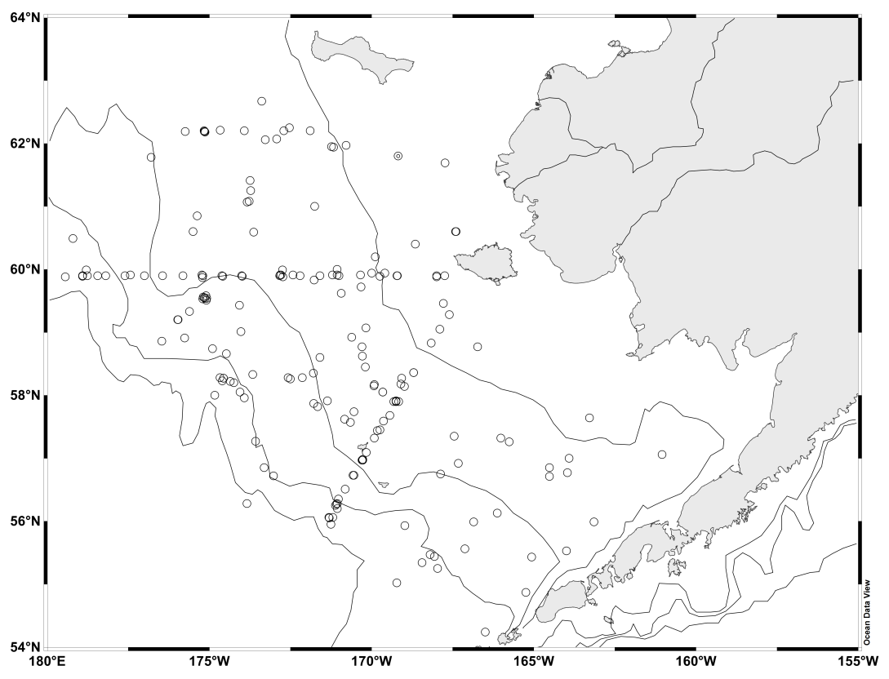
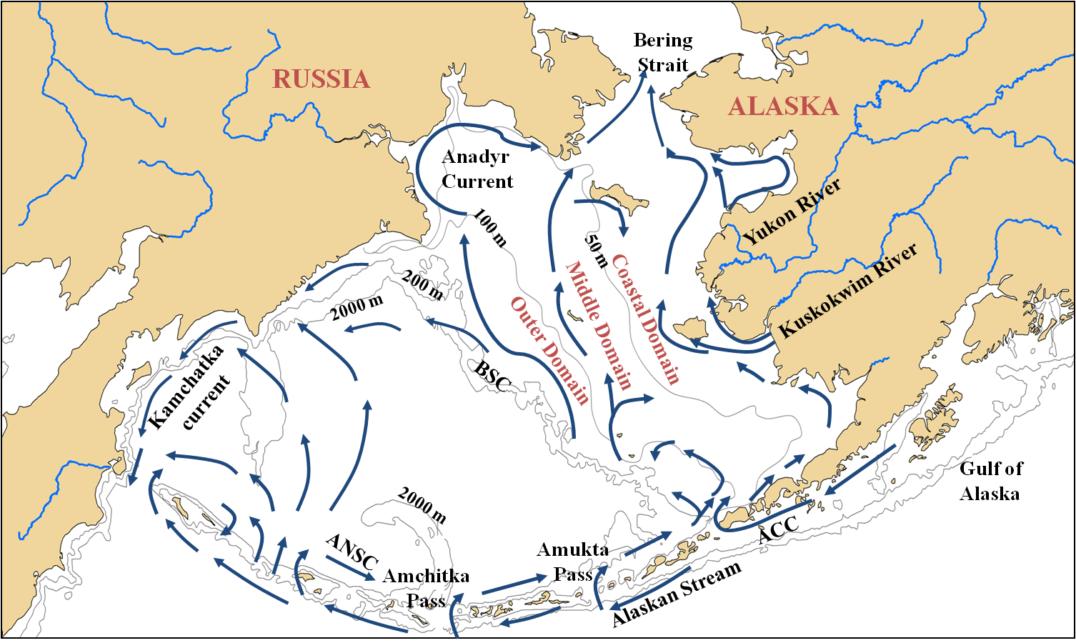
Study Area
The Bering Sea is among the most productive marine ecosystems in the world that supports nearly half of the U.S fishery catch.
Over the last few decades the Bering Sea has been subjected to large climatic fluctuations and is among the most rapidly changing marine ecosystem.
Notes:
Most productive ecosystem
blue arrows show the general circulation pattern…. The shelf can be divided into 3 distinct domains the coastal, middle and outer based on hydrography. Each domain has distinct characteristics in terms of temperature, nutrients, PP. Largest PP seen near the shelf break and the vicinity of central front. The RHS fig shows the aphy concentration.
In recent decades the region has been subjected to large climatic fluctuations, which has caused rapid changes in the marine ecosystem. Cold-water, Arctic species have been replaced by organisms more indicative of temperate zones and reduced sea-ice cover has been proposed to favor a „pelagic‟ dominated ecosystem over the more typical „benthic‟ dominated ecosystem indicative of Arctic Ocean shelves including the Northern Bering Sea shelf [Piepenburg, 2005]. Extensive jellyfish populations have reoccurred [Napp et al., 2002], and the usual prominent coccolithophorid blooms of the southeastern Bering Sea [Merico et al., 2006; Stockwell et al., 2001] have been absent over the last few years. While most of these changes have been observed on the southeastern shelf, there is some evidence of change on the northern shelf as well [Grebmeier et al., 2006; Overland and Stabeno, 2004]. Many of these changes have been attributed to global climate change and recent fluctuations in sea ice extent [Hunt et al., 2002; Rho and Whitledge, 2007].
A need for both short- and long- term monitoring is thus needed to identify the mechanisms linking short- and long-term physical changes to ecosystem variability, with longer term monitoring being critical for understanding and predicting changes in this ecosystem [Sigler et al., 2010]. Remote sensing has considerable potential for monitoring and measuring the effects of such climate-driven changes on this ecosystem.

Slide 3
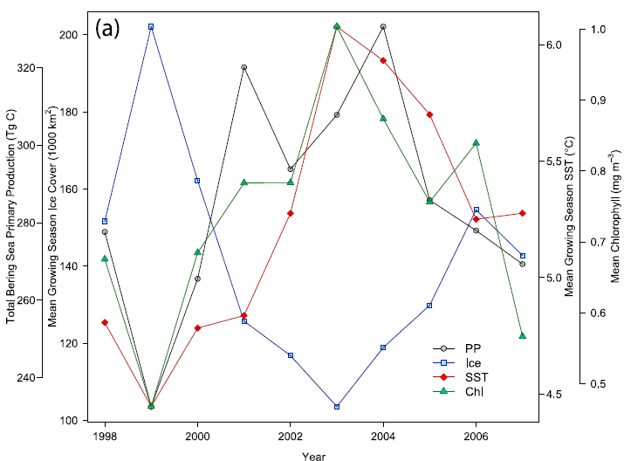
Study Area
Brown et al., 2011, JGR
Naik and D’Sa, 2010, SPIE
Inter-annual variability in phytoplankton and climate.
Notes:
As examples, the LHS fig shows the PP from remote sensing in the Arctic , x-axis we have the years and y axis we have the PP, this stduy showed that the annual PP has increased in the Arctic in recent years which was correlated to open water area.
Another example is the study in The Bering Sea using EOF orthogonal functions. We have the SST EOF mode and chl EOF mode and climate indices on the y-axis and years on the x-axis. This study showed that trends obtained from RS were correlated to that obtain from climatic indices. For e.g. the ICI which gives the winter ice cover in the study area, -ve values low ice cover, +ve values more ice cover, low ice cover +ve values of SST and high ice cover –ve values of SST.
So RS serves as an important tool on our monitoring and predictive ability of this ecosystem however these results are depended on the accuracy of the products.

Slide 4
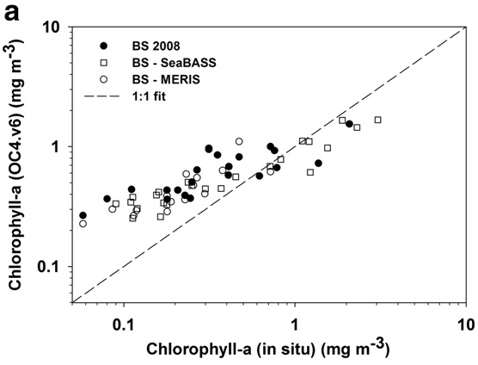
The Problem
Large discrepancies between satellite and in-situ measured chlorophyll‐a concentrations in the high northern latitudes.
Chlorophyll‐a derived for the Bering Sea using global ocean color algorithms are underestimated. While some other study demonstrated that chlorophyll-a was overestimated.
Discrepancies attributed to the lower specific phytoplankton absorption, high CDOM and limited data for the development of algorithms.
Naik et al., 2013
Notes:
In the arctic large discrepancies between in-situ and satellite retrieved.
In the bering sea for chlorophyll---some show chl overestimated others show chl underestimate.
although the discrepancies in the arctic are known to a certain extent to be due to CODM and lower spaphy, but discrepancies in BS unknown as no studies have been done in BS.

Slide 5
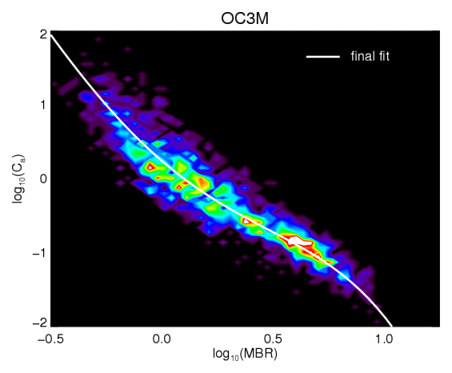
Ocean Color Chlorophyll-a Algorithms
r = max[ρ_{wN}(λ₁)/ρ_{wN}(λ₃), ρ_{wN}(λ₂)/ρ_{wN}(λ₃)]
ρ_{wN}(λ) = π⋅nL_{w}(λ)/F₀(λ)
For e.g. standard OC3M.v6 chlorophyll-a algorithm:
log₁₀[Chl-a^{(OC3M)}] = 0.243 − 2.582 r + 1.705 r² − 0.341 r³ − 0.881 r⁴
r = max[ρ_{wN}(443)/ρ_{wN}(551), ρ_{wN}(488)/ρ_{wN}(551)]
http://oceancolor.gsfc.nasa.gov/REPROCESSING/R2009/ocv6/

Slide 6
Data and Methods
NOAA-MSL12 ocean color data processing system used to process and produce MODIS-Aqua ocean color products.
In situ Chl-a data - BEST data archive -NSF funded project in the Bering Sea (http://www.nprb.org/bering-sea-project).
In situ normalized water-leaving radiance nL_{w}(λ) - SeaWiFS Bio-optical Archive and Storage System (SeaBASS) (http://seabass.gsfc.nasa.gov/) and a research cruise in July 2008 in the region.
MODIS-Aqua Level-1B data (Collection 6) - NASA MODIS Adaptive Processing System (MODAPS) website (http://ladsweb.nascom.nasa.gov).
Sea ice extent data (2003–2012) - National Snow and Ice data center ( https://nsidc.org/).
Wind speed data - NCEP/NCAR reanalysis project (http://www.esrl.noaa.gov/psd/)
MODIS-Aqua Level-2 sea surface temperature (SST) - NASA Ocean Biology Processing Group (OBPG) (http://oceancolor.gsfc.nasa.gov).

Slide 7
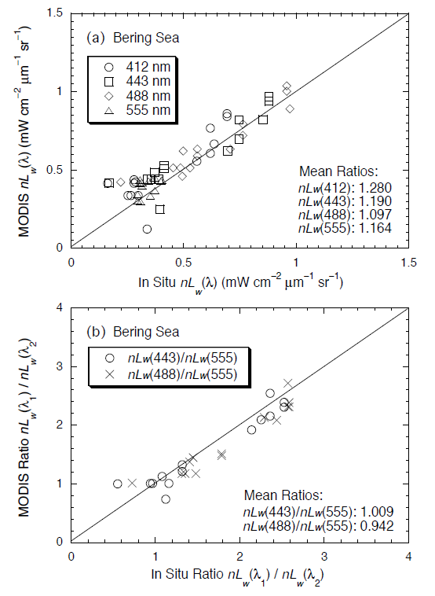
MODIS-Aqua-derived nL_{w}(λ)

Slide 8
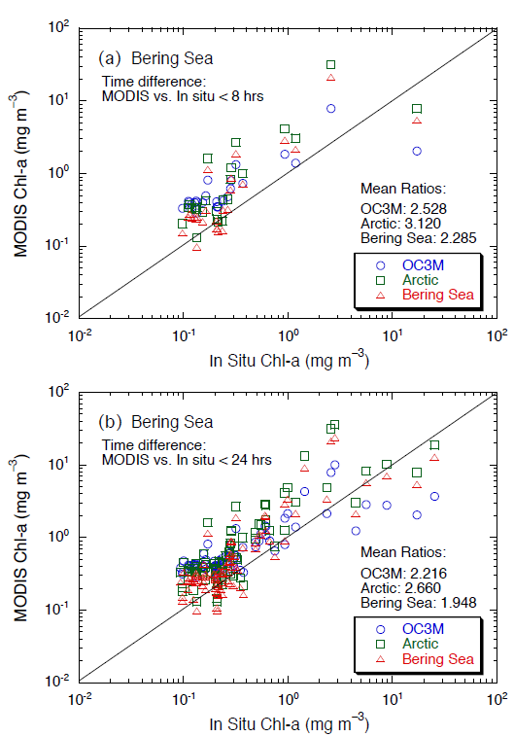
MODIS-Aqua-derived Chlorophyll-a
Overestimated at lower chlorophyll-a and underestimated at higher chlorophyll-a

Slide 9
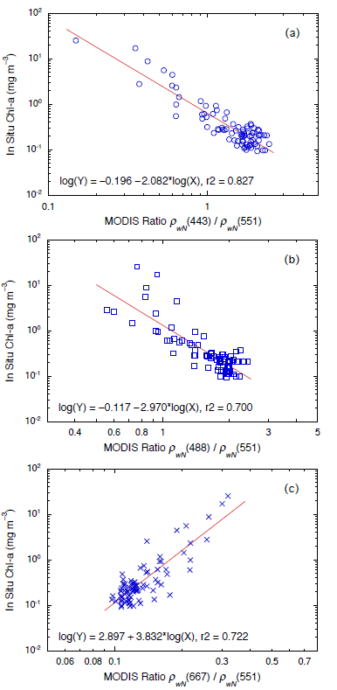
New Blended Chlorophyll-a Algorithm
log₁₀[Chl-a⁽¹⁾] = −0.041 − 2.314 MBR
for MBR > 1.4
where MBR = max (ρ_{wN}(443,488)/ρ_{wN}(551))
log₁₀[Chl-a⁽²⁾] = 3.002 + 3.935 r(667,551)
for MBR < 1.0
where, r(667,551) = ρ_{wN}(667)/ρ_{wN}(551)
Chl-a = W Chl-a⁽¹⁾ + (1−W) Chl-a⁽²⁾
W = −2.5 + 2.5 MBR
for 1.0 ≤ MBR ≤ 1.4

Slide 10
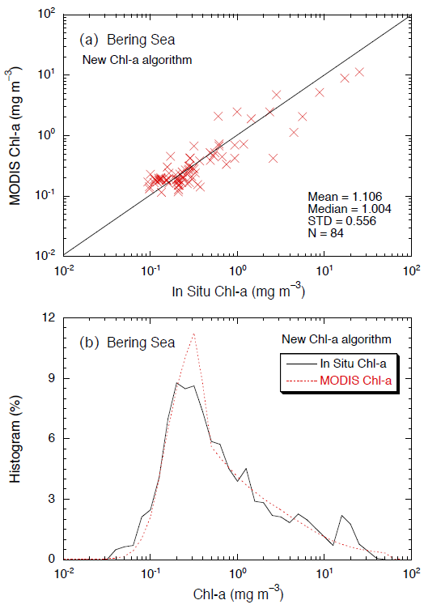
New Algorithm Performance

Slide 11
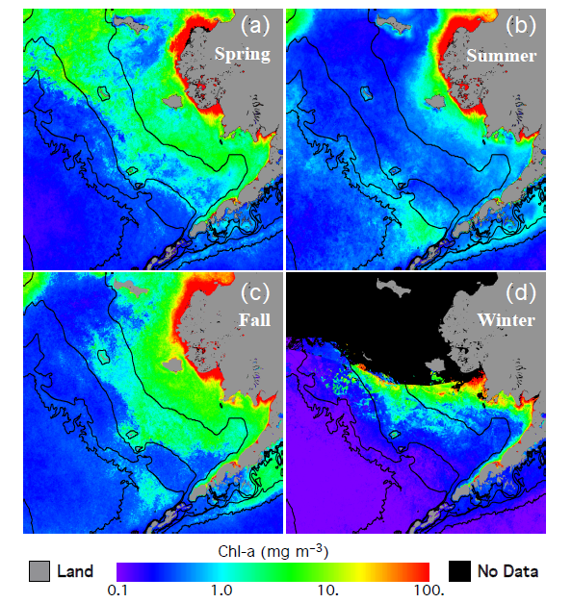
Seasonal Chlorophyll-a Patterns

Slide 12
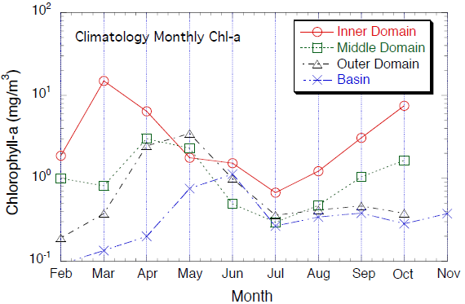
Monthly Chlorophyll-a
Regional trends within eastern Bering Sea shelf.

Slide 13
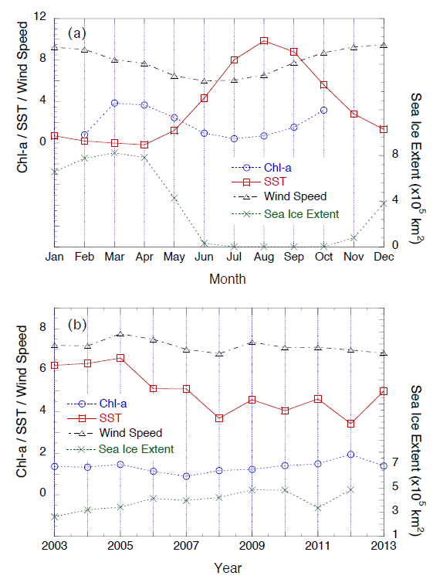
Chlorophyll-a Trends
No long term trend in chlorophyll-a but strong covariation with SST and sea ice extent.

Slide 14
Conclusions
The MODIS-Aqua derived radiances using MSL12 showed good agreement with in-situ measured radiances.
Standard and current ocean color algorithms either overestimate or underestimate chlorophyll-a in the Bering Sea.
A new algorithm blending the blue-green ratio and red-green ratio was developed which showed good performance.
Chlorophyll-a exhibited strong seasonal and inter-annual variability closely tied to the physical environment.
No significant difference between ‘warm’ and ‘cold’ years.
No apparent trend of increase or decrease in phytoplankton biomass associated with variability in the physical environment for the 11 years of the study period.
The new blended Chl-a algorithm proposed in this study can be applied to MODIS-Aqua as well as ocean color data from other sensors (e.g., SeaWiFS, VIIRS, etc.).

Slide 15
THANKS!

